Slide 1

B.E. III-SEMESTER
Data Structure (DS)
Presented By
Dr. Nagaratna P Hegde
Professor, CSE DEPT.
VCE, HYDERABAD

Slide 2
COURSE OBJECTIVES
Identify and use appropriate data structure for a given problem with effective utilization of space and time.
Describe the linear and nonlinear data structures
Analyze the complexities of different sorting techniques

Slide 3
COURSE OUTCOMES
Compute time and space complexities of Algorithms. Design a solution to a given problem using arrays.
Develop applications using stacks, queues and linked lists.
Choose the appropriate nonlinear data structure and perform operations on them.
Choose suitable sorting technique to maximize the performance of the solution. Select the hashing technique to perform dictionary operations.
5. Explain operations on Efficient Binary Search Trees and Multiway Search Trees.

Slide 4
SYLLABUS
UNIT – I:
Basic concepts: Algorithm Specification - Introduction, Recursive algorithms, Data Abstraction, Performance analysis- time complexity and space complexity, Asymptotic Notation-Big O, Omega and Theta notations. Arrays: Arrays - ADT, Polynomials, Sparse matrices, Strings-ADT, Pattern Matching
UNIT – II:
Stacks and Queues: Stacks, Stacks using dynamic arrays, Queues, Circular Queues using dynamic arrays, A Mazing Problem, Evaluation of Expressions - Evaluating Postfix Expression, Infix to Postfix.
Linked Lists: Singly Linked Lists and Chains, Linked Stacks and Queues, Polynomials, Operations for Circularly linked lists, Equivalence Classes, Sparse matrices, Doubly Linked Lists

Slide 5
SYLLABUS …
UNIT – III:
Trees: Introduction, Binary Trees, Binary Tree Traversals, Heaps, Binary Search trees (BST): Definition, Searching a BST, Insertion into a BST, Deletion from a BST.
Graphs: The Graph ADT, Elementary graph operations, Minimum Cost Spanning Trees- Kruskal's Algorithm, Prim's Algorithm.
UNIT – IV:
Sorting: Insertion Sort, Quick sort, Merge sort, Heap sort, Sorting on Several Keys, List and Table Sorts.
Hashing :Introduction, Static Hashing: Hash tables, Hash functions, Overflow handlings.
UNIT – V:
Efficient Binary Search Trees: AVL Trees, Red-Black Trees, Splay Trees. Multiway Search Trees: m-way search trees-Definition and properties, Searching an m-way search tree, B-Trees-Definition and properties, Number of Elements in a B-Tree, Insertion into a B-Tree and Deletion from a B-Tree.

Slide 6
SYLLABUS …
Learning Resources:
Horowitz E, Sahni S and Susan Anderson-Freed, Fundamentals of Data structures in C, 2nd Edition(2008), Universities Press.
Mark A Weiss, Data Structures and Algorithm Analysis In C, 2nd Edition (2002), Pearson.
Kushwaha D. S and Misra A.K, Data Structures A Programming Approach with C, Second Edition(2014), PHl.
Gilberg R. F and Forouzan B. A, Data Structures: A Pseudocode Approach with C, Second Edition(2007), Cengage Leaming
https://ocw.mit.edu/courses/electrical-engineering-and-computer-science/6-006- introduction-to-algorithms-fall-2011/lecture-videos
http://nptel.ac.in/courses/106106127/
http://www.nptel.ac.in/courses/106102064

Slide 7
UNIT-I
PART-1: Basic Concepts
  Algorithm Specification – Introduction
  Data Abstraction
  Performance analysis- time complexity and space complexity
  Asymptotic Notation-Big O, Omega and Theta notations
PART-2: Arrays and Strings
  Arrays – ADT
  Polynomials
  Sparse matrices
  Strings-ADT
  Pattern Matching

Slide 8
Algorithm
An algorithm is a step by step representation or a procedure for solving a problem.
It is a method of finding a right solution to a problem or to a different problem or to a different problem breaking into simple cases.

Slide 9
Algorithm
Finiteness:
An algorithm should terminate at finite number of steps.
Definiteness:
Each step of an algorithm must be precisely stated.
Effectiveness:
It consists of basic instructions that are realizable.
This means that the instructions can be performed by using the given inputs in a finite amount of time.
Input:
An algorithm accepts zero or more inputs.
Output:
It produces at least one output.

Slide 10
Data Structure Definition
The data structure can be defined as the collection of elements and all the possible operations which are required for those set of elements.
The data structures can be implemented by building the suitable algorithms for them.
A data structure is a particular way of organizing data in a computer (memory) so that it can be used effectively.
Data structure is a data organization, management, and storage format that enables efficient access and modification.
Data Structures classified in to two categories: Primitive and Non-Primitive.

Slide 11
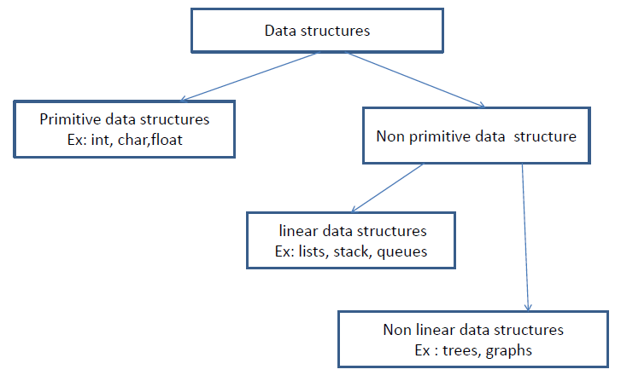
Types of Data Structures

Slide 12
Types of Data Structures
Primitive Data Structures are the basic data structures that directly operate upon the machine instructions.
Example: Integer, Float, Char, Double and Pointer
Non-primitive data structures are more complicated data structures and are derived from primitive data structures.
They emphasize on grouping same or different data items with relationship between each data item.
Non-Primitive DS further divided in to two type:
Linear (Sequential): Arrays, Linked Lists, Stacks, Queues
Non-Linear (Random): Trees, Graphs

Slide 13
Common Operations on Data Structures
Read / View
Write / Store
Searching
Sorting – Ascending / Descending
Insertion
Deletion
Updation
(Youtube Video Link: https://youtu.be/DFpWCl_49i0)

Slide 14
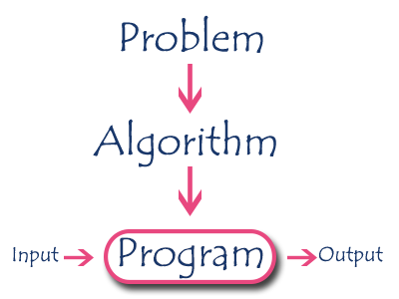
1. Introduction to Algorithm
An algorithm is a step by step procedure to solve a problem.
In normal language, algorithm is defined as a sequence of statements which are used to perform a task.
In computer science, an algorithm can be defined as, sequence of unambiguous instructions used for solving a problem, which can be implemented (as a program) on a computer.

Slide 15
Algorithm Specifications / Properties
Every algorithm must satisfy the following specifications:
  Input - Every algorithm must take zero or more number of input values from external.
  Output - Every algorithm must produce an output as result.
  Definiteness - Every statement/instruction in an algorithm must be clear and unambiguous (only one interpretation)
  Finiteness - For all different cases, the algorithm must produce result within a finite number of steps.
  Effectiveness - Every instruction must be basic enough to be carried out and it also must be feasible.
  (YouTube Video URL: https://www.youtube.com/watch?v=FbYzBWdhMb0)

Slide 16
Algorithm Example
Problem Statement: Find the largest number in the given list of numbers?
Input: A list L of positive integer numbers. (List must contain at least one number).
Output: The largest number max in the given list of positive integer numbers.
Algorithm:
Step 1: Define a variable 'max' and initialize with '0'.
Step 2: Compare first number (say 'x') in the list 'L' with 'max', if 'x' is larger than 'max', set 'max' to 'x'.
Step 3: Repeat step 2 for all numbers in the list 'L'.
Step 4: Display the value of 'max' as a result.

Slide 17
PSEUDO CODE
It is a representation of algorithm in which instruction sequence can be given with the help of programming constructs. or
Pseudo code, on the other hand, is not a programming language, but simply an informal way of describing a program.
Example: write an algorithm to find sum of 1 to n numbers
Algorithm sum(1,n)
{
Result:=0;
for i :=1 to n do Result := Result + i;
Write Result
}

Slide 18
2. Recursive algorithms
In computer science, most of the algorithms are implemented by using functions (which are part of program and invoked whenever required).
We can view a function as something that is invoked (called) by another function. It executes its code and then returns control to the calling function.
Here, a function can call themselves (by itself) or it may call another function. The function which calls by itself is called as Direct Recursive function or Recursive function.
The algorithms which uses recursive functions to solve the problems are called Recursive Algorithms.
These recursive algorithms are easier to understand when compared to its iterative counterpart.

Slide 19

Example
Write an recursive algorithm to find factorial of given number.
Algorithm factorial(n)
{
fact=1
if (n > 1) fact = n* factorial(n-1);
Return (fact);
}
In the above pseudo code, the algorithm factorial called itself until the given number is greater than one.

Slide 20
3. Data Abstraction
Data Abstraction is a process of providing only the essential details to the outside world and hiding the internal details, i.e., representing only the essential details in the program.
Data Abstraction is a programming technique that depends on the separation of the interface and implementation details of the program.
C provides a great level of abstraction. For example, printf() function is used to display message along with result without knowing the algorithm of the function printf().
Data Abstraction avoids the code duplication, i.e., programmer does not have to undergo the same tasks every time to perform the similar operation.
Internal implementation can be changed without affecting the user level code.

Slide 21
Abstract Data Type (ADT)…
An abstract data type(ADT) is a data type that is organized in such a way that the specification of the objects and the operations on the objects is separated from the representation of the objects and the implementation of the operations.
The definition of ADT only mentions what operations are to be performed but not how these operations will be implemented.
It does not specify how data will be organized in memory and what algorithms will be used for implementing the operations.
It is called “abstract” because it gives an implementation-independent view.
The process of providing only the essentials and hiding the details is known as abstraction.

Slide 22
How to create programs
Requirements
Analysis: bottom-up vs. top-down
Design: data objects and operations
Refinement and Coding
Verification
  Program Proving
  Testing
  Debugging
CHAPTER 1

Slide 23
Specification vs. Implementation
Operation specification
  function name
  the types of arguments
  the type of the results
Implementation independent
CHAPTER 1

Slide 24
*Structure 1.1:Abstract data type Natural_Number (p.17) structure Natural_Number is objects: an ordered subrange of the integers starting at zero and ending at the maximum integer (INT_MAX) on the computer functions: for all x, y ∈ Nat_Number; TRUE, FALSE ∈ Boolean and where +, -, <, and == are the usual integer operations.
Nat_No Zero ( ) ::= 0
Boolean Is_Zero(x) ::= if (x) return FALSE else return TRUE
Nat_No Add(x, y) ::= if ((x+y) <= INT_MAX) return x+y else return INT_MAX
Boolean Equal(x,y) ::= if (x== y) return TRUE else return FALSE
Nat_No Successor(x) ::= if (x == INT_MAX) return x else return x+1
Nat_No Subtract(x,y) ::= if (x<y) return 0 else return x-y end Natural_Number
::= is defined as
CHAPTER 1

Slide 25
Measurements
Criteria
  Is it correct?
  Is it readable?
  …
Performance Analysis (machine independent)
  space complexity: storage requirement
  time complexity: computing time
Performance Measurement (machine dependent)
CHAPTER 1

Slide 26
Space Complexity
S(P)=C+S_{P}(I)
Fixed Space Requirements (C)
Independent of the characteristics of the inputs and outputs
  instruction space
  space for simple variables, fixed-size structured variable, constants
Variable Space Requirements (S_{P}(I))
depend on the instance characteristic I
  number, size, values of inputs and outputs associated with I
  recursive stack space, formal parameters, local variables, return address
CHAPTER 1

Slide 27
*Program 1.9: Simple arithmetic function (p.19) float abc(float a, float b, float c)
{ return a + b + b * c + (a + b - c) / (a + b) + 4.00;
}
*Program 1.10: Iterative function for summing a list of numbers (p.20) float sum(float list[ ], int n)
{ float tempsum = 0; int i; for (i = 0; i<n; i++) tempsum += list [i]; return tempsum;
}
S_{abc}(I) = 0
S_{sum}(I) = 0
Recall: pass the address of the
first element of the array &
pass by value
CHAPTER 1

Slide 28
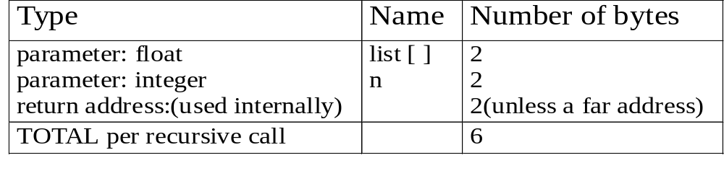
*Program 1.11: Recursive function for summing a list of numbers (p.20) float rsum(float list[ ], int n)
{ if (n) return rsum(list, n-1) + list[n-1]; return 0;
}
*Figure 1.1: Space needed for one recursive call of Program 1.11 (p.21)
S_{sum}(I)=S_{sum}(n)=6n
Assumptions:
CHAPTER 1

Slide 29
Time Complexity
T(P)=C+T_{P}(I)
Compile time (C)
independent of instance characteristics
run (execution) time T_{P}
Definition
A program step is a syntactically or semantically meaningful program segment whose execution time is independent of the instance characteristics.
Example
  abc = a + b + b * c + (a + b - c) / (a + b) + 4.0
  abc = a + b + c
T_{P}(n)=c_{a}ADD(n)+c_{s}SUB(n)+c_{l}LDA(n)+c_{st}STA(n)
Regard as the same unit
machine independent
CHAPTER 1

Slide 30
Methods to compute the step count
Introduce variable count into programs
Tabular method
  Determine the total number of steps contributed by each statement
  step per execution × frequency
  add up the contribution of all statements
CHAPTER 1

Slide 31
*Program 1.12: Program 1.10 with count statements (p.23) float sum(float list[ ], int n)
{ float tempsum = 0; count++; /* for assignment */ int i; for (i = 0; i < n; i++) { count++; /*for the for loop */ tempsum += list[i]; count++; /* for assignment */
} count++; /* last execution of for */ return tempsum; count++; /* for return */
}
Iterative summing of a list of numbers
2n + 3 steps
CHAPTER 1

Slide 32
*Program 1.13: Simplified version of Program 1.12 (p.23) float sum(float list[ ], int n)
{ float tempsum = 0; int i; for (i = 0; i < n; i++) count += 2; count += 3; return 0;
}
2n + 3 steps
CHAPTER 1

Slide 33
*Program 1.14: Program 1.11 with count statements added (p.24) float rsum(float list[ ], int n)
{ count++; /*for if conditional */ if (n) { count++; /* for return and rsum invocation */ return rsum(list, n-1) + list[n-1];
} count++; return list[0];
}
Recursive summing of a list of numbers
2n+2
CHAPTER 1

Slide 34
*Program 1.15: Matrix addition (p.25) void add( int a[ ] [MAX_SIZE], int b[ ] [MAX_SIZE], int c [ ] [MAX_SIZE], int rows, int cols)
{ int i, j; for (i = 0; i < rows; i++) for (j= 0; j < cols; j++) c[i][j] = a[i][j] +b[i][j];
}
Matrix addition
CHAPTER 1

Slide 35
*Program 1.16: Matrix addition with count statements (p.25) void add(int a[ ][MAX_SIZE], int b[ ][MAX_SIZE], int c[ ][MAX_SIZE], int row, int cols )
{ int i, j; for (i = 0; i < rows; i++){ count++; /* for i for loop */ for (j = 0; j < cols; j++) { count++; /* for j for loop */ c[i][j] = a[i][j] + b[i][j]; count++; /* for assignment statement */
} count++; /* last time of j for loop */
} count++; /* last time of i for loop */
}
2rows * cols + 2 rows + 1
CHAPTER 1

Slide 36
*Program 1.17: Simplification of Program 1.16 (p.26) void add(int a[ ][MAX_SIZE], int b [ ][MAX_SIZE], int c[ ][MAX_SIZE], int rows, int cols)
{ int i, j; for( i = 0; i < rows; i++) { for (j = 0; j < cols; j++) count += 2; count += 2;
} count++;
}
2rows × cols + 2rows +1
Suggestion: Interchange the loops when rows >> cols
CHAPTER 1

Slide 37
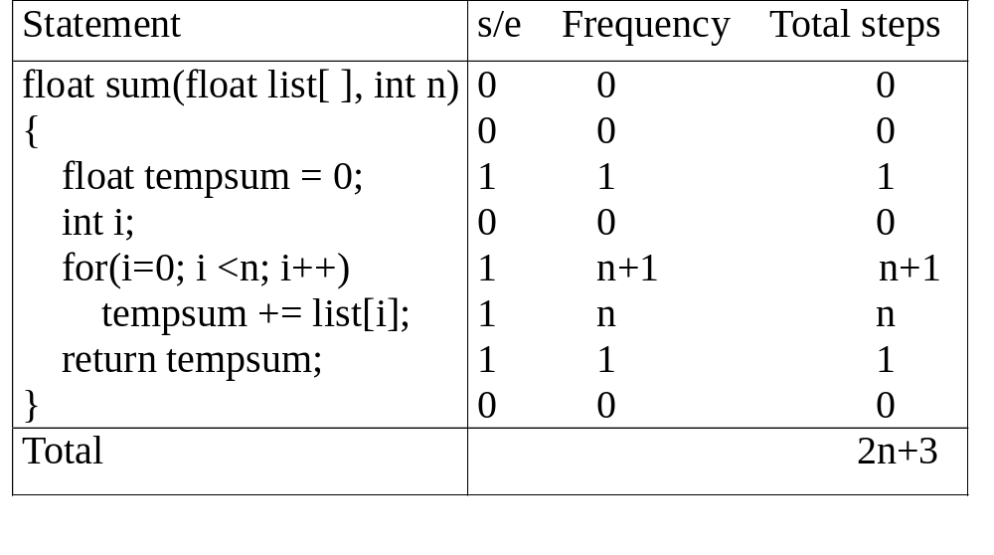
*Figure 1.2: Step count table for Program 1.10 (p.26)
Tabular Method
Iterative function to sum a list of numbers
steps/execution
CHAPTER 1

Slide 38
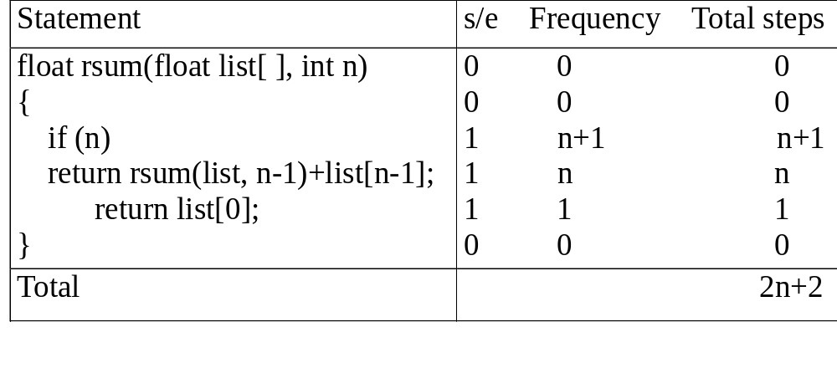
*Figure 1.3: Step count table for recursive summing function (p.27)
Recursive Function to sum of a list of numbers
CHAPTER 1

Slide 39
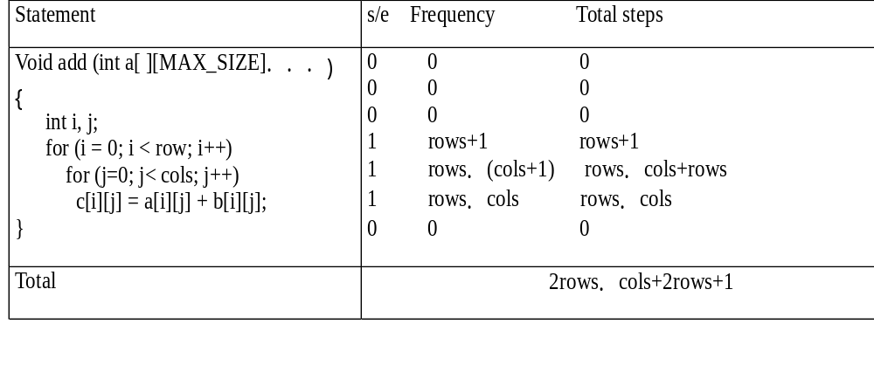
*Figure 1.4: Step count table for matrix addition (p.27)
Matrix Addition
CHAPTER 1

Slide 40
*Program 1.18: Printing out a matrix (p.28) void print_matrix(int matrix[ ][MAX_SIZE], int rows, int cols)
{ int i, j; for (i = 0; i < row; i++) { for (j = 0; j < cols; j++) printf(“%d”, matrix[i][j]); printf( “\n”);
}
}
Exercise 1
CHAPTER 1

Slide 41
*Program 1.19:Matrix multiplication function(p.28) void mult(int a[ ][MAX_SIZE], int b[ ][MAX_SIZE], int c[ ][MAX_SIZE])
{ int i, j, k; for (i = 0; i < MAX_SIZE; i++) for (j = 0; j< MAX_SIZE; j++) { c[i][j] = 0; for (k = 0; k < MAX_SIZE; k++) c[i][j] += a[i][k] * b[k][j];
}
}
Exercise 2
CHAPTER 1

Slide 42
*Program 1.20:Matrix product function(p.29) void prod(int a[ ][MAX_SIZE], int b[ ][MAX_SIZE], int c[ ][MAX_SIZE], int rowsa, int colsb, int colsa)
{ int i, j, k; for (i = 0; i < rowsa; i++) for (j = 0; j< colsb; j++) { c[i][j] = 0; for (k = 0; k< colsa; k++) c[i][j] += a[i][k] * b[k][j];
}
}
Exercise 3
CHAPTER 1

Slide 43
*Program 1.21:Matrix transposition function (p.29) void transpose(int a[ ][MAX_SIZE])
{ int i, j, temp; for (i = 0; i < MAX_SIZE-1; i++) for (j = i+1; j < MAX_SIZE; j++)
SWAP (a[i][j], a[j][i], temp);
}
Exercise 4
CHAPTER 1

Slide 44
Asymptotic Notation (O)
Definition
f(n) = O(g(n)) iff there exist positive constants c and n₀ such that f(n) ≤ cg(n) for all n, n ≥ n₀.
Examples
  3n+2=O(n) /* 3n+2≤4n for n≥2 */
  3n+3=O(n) /* 3n+3≤4n for n≥3 */
  100n+6=O(n) /* 100n+6≤101n for n≥10 */
  10n²+4n+2=O(n²) /* 10n²+4n+2≤11n² for n≥5 */
  6*2^{n}+n²=O(2^{n}) /* 6*2^{n}+n² ≤7*2^{n} for n≥4 */
CHAPTER 1

Slide 45
Example
Complexity of c₁n²+c₂n and c₃n
  for sufficiently large of value, c₃n is faster than c₁n²+c₂n
  for small values of n, either could be faster
    c₁=1, c₂=2, c₃=100 --> c₁n²+c₂n ≤ c₃n for n ≤ 98
    c₁=1, c₂=2, c₃=1000 --> c₁n²+c₂n ≤ c₃n for n ≤ 998
  break even point
    no matter what the values of c1, c2, and c3, the n beyond which c₃n is always faster than c₁n²+c₂n
CHAPTER 1

Slide 46
O(1): constant
O(n): linear
O(n²): quadratic
O(n³): cubic
O(2^{n}): exponential
O(logn)
O(nlogn)
CHAPTER 1

Slide 47
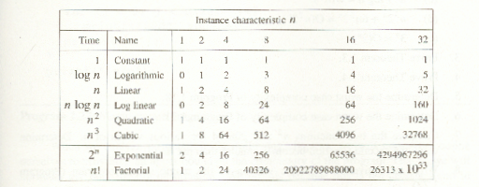
*Figure 1.7:Function values (p.38)
CHAPTER 1

Slide 48
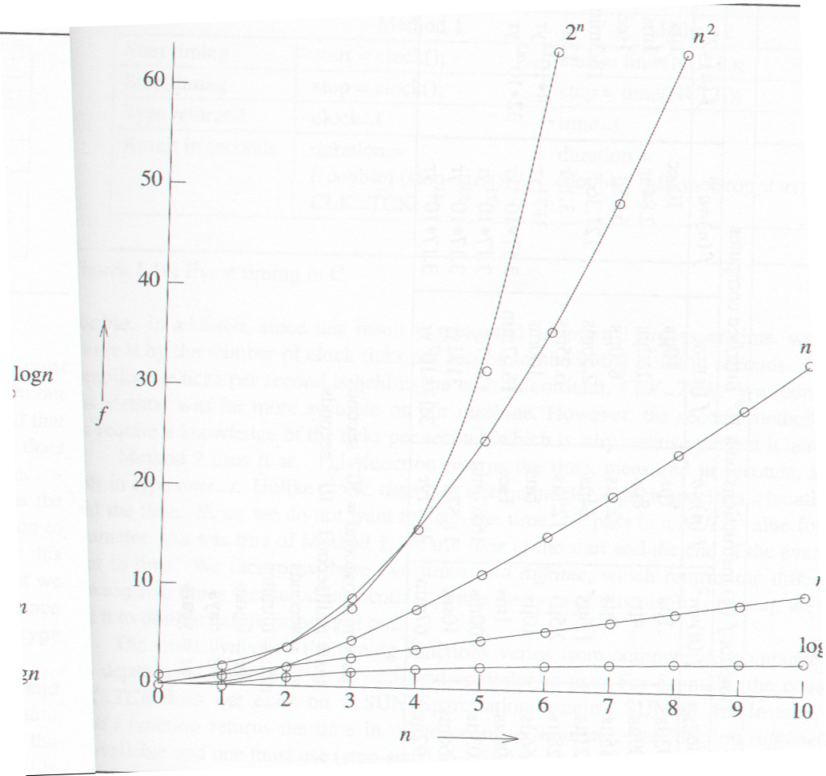
*Figure 1.8:Plot of function values(p.39)
nlogn
n
logn
CHAPTER 1

Slide 49
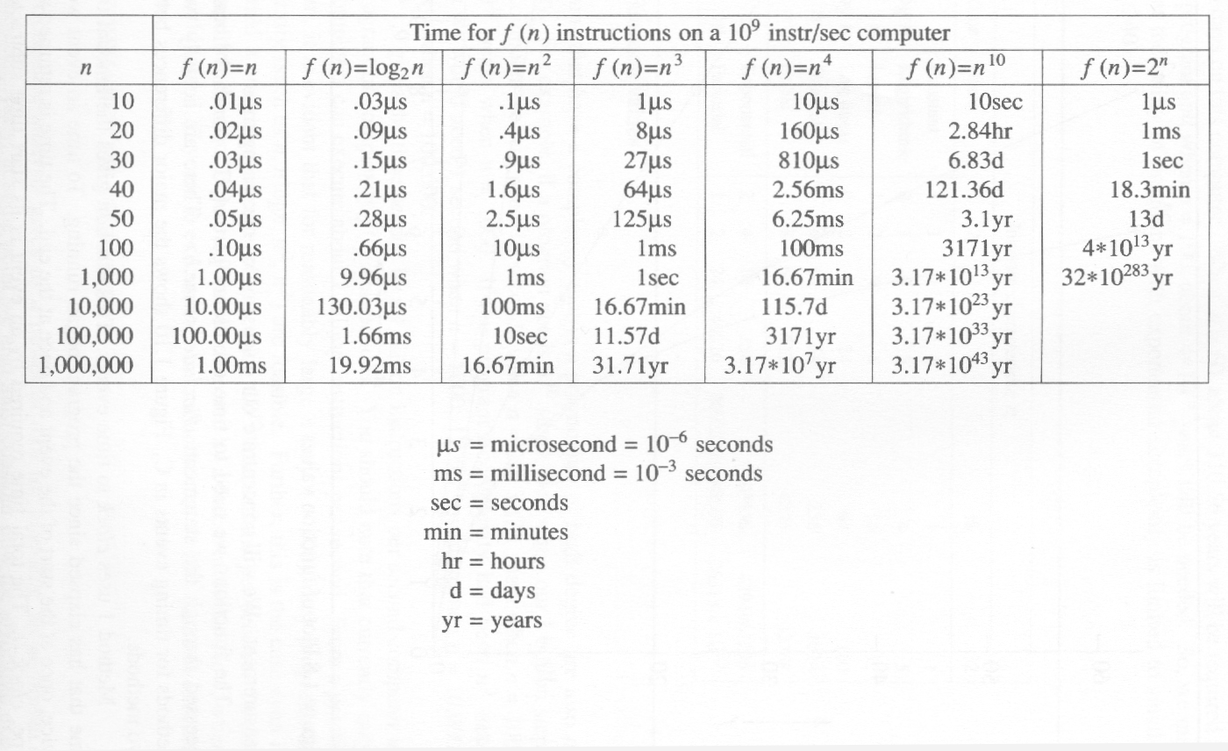
*Figure 1.9:Times on a 1 billion instruction per second computer(p.40)
CHAPTER 1

